Slide 1
Sugar Beet and Weed Classification using YOLOv12s

Slide 2
Presented by
Ahmed Mahmoud Abdelazem
Mohamed Ehab Abdelhafeez

Slide 3

Project overview

Slide 4
Problem definition
Project Objective
Our project focuses on developing a system capable of accurately predicting and differentiating between sugar beets and surrounding weed using advanced image recognition and classification techniques.
Why This Matters
Weeds compete with sugar beets for essential resources such as water, sunlight, and nutrients, significantly affecting crop health and yield.
Misidentification or broad herbicide application can harm crops, reduce overall efficiency, and increase operational costs.

Slide 5
Dataset
The dataset used in this project is the comprehensive Sugar Beets dataset from Roboflow:
Source:
Sugar Beets Dataset on Roboflow
Contents:
High-quality images of sugar beet fields with detailed annotations for sugar beets and various weed species
Split:
Train/Validation/Test sets for robust model evaluation

Slide 6
Features
The system is designed to perform fast and efficient real-time detection and classification of objects in agricultural fields, specifically distinguishing between sugar beets and weeds.
At the heart of the system lies the YOLOv12s (You Only Look Once version 12 small) deep learning architecture, known for its superior speed and accuracy in object detection tasks.
The system has been fine-tuned to perform robustly in diverse environmental settings, including varying light conditions, occlusions, soil backgrounds, and weather variations.
The detection system supports a wide range of image input formats, making it compatible with various imaging sources such as drone-captured images, tractor-mounted cameras, and handheld field devices.

Slide 7
Yolo V12
YOLO stands for 'You Only Look Once’ and it's a family of real-time object detection models known for their speed and accuracy.
YOLO models detect and classify objects in a single pass through the neural network, making them extremely efficient for tasks like detecting objects in images or video streams.
YOLOv12 is one of the latest versions in this series. It builds upon the strengths of earlier YOLO models by introducing improvements in architecture, training strategies, and feature extraction.
YOLOv12 is designed to offer: Higher detection accuracy, especially for small and overlapping objects.
Better speed-performance balance, meaning it can run in real time on devices with limited computing power.

Slide 8
Training process
The model training process involved:
Data Preparation: Downloaded and preprocessed the Sugar Beets dataset from Roboflow
Model Configuration: Set up the YOLOv12s model with optimized hyperparameters
Training Environment: Utilized Kaggle's GPU acceleration for efficient training
Monitoring: Tracked key metrics during training using TensorBoard
Validation: Regularly validated performance against a held-out validation set
The training was performed on Kaggle: Sugar Beet Classification Notebook

Slide 9
Model performance
The figure in the next slide illustrates the training and validation performance of the YOLOv12s model over 50 epochs, highlighting both loss reduction and metric improvements:
Training Loss Curves (Top Row)
Box Loss, Classification Loss, and DFL Loss steadily decrease, indicating effective learning and improved bounding box regression and class predictions.
Validation Loss Curves (Bottom Row)
Validation losses follow a similar decreasing trend, confirming the model generalizes well without overfitting.

Slide 10
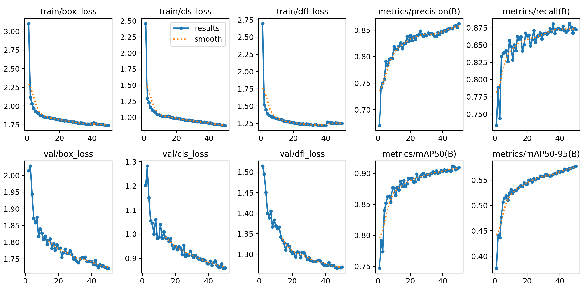
Model performance

Slide 11
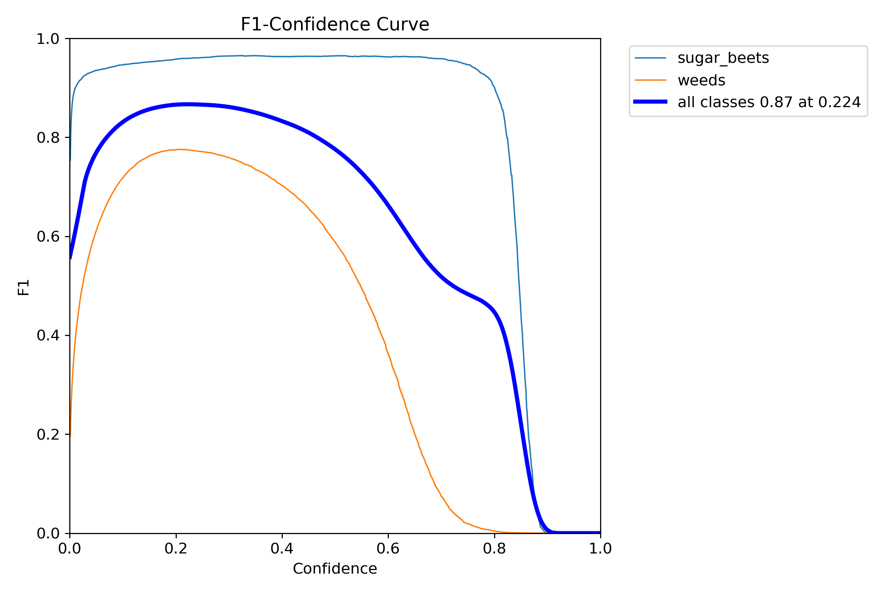
Model performance metrics
The F1-Score curve demonstrates the model's balance between precision and recall, providing insights into its ability to classify both positive and negative instances correctly.

Slide 12
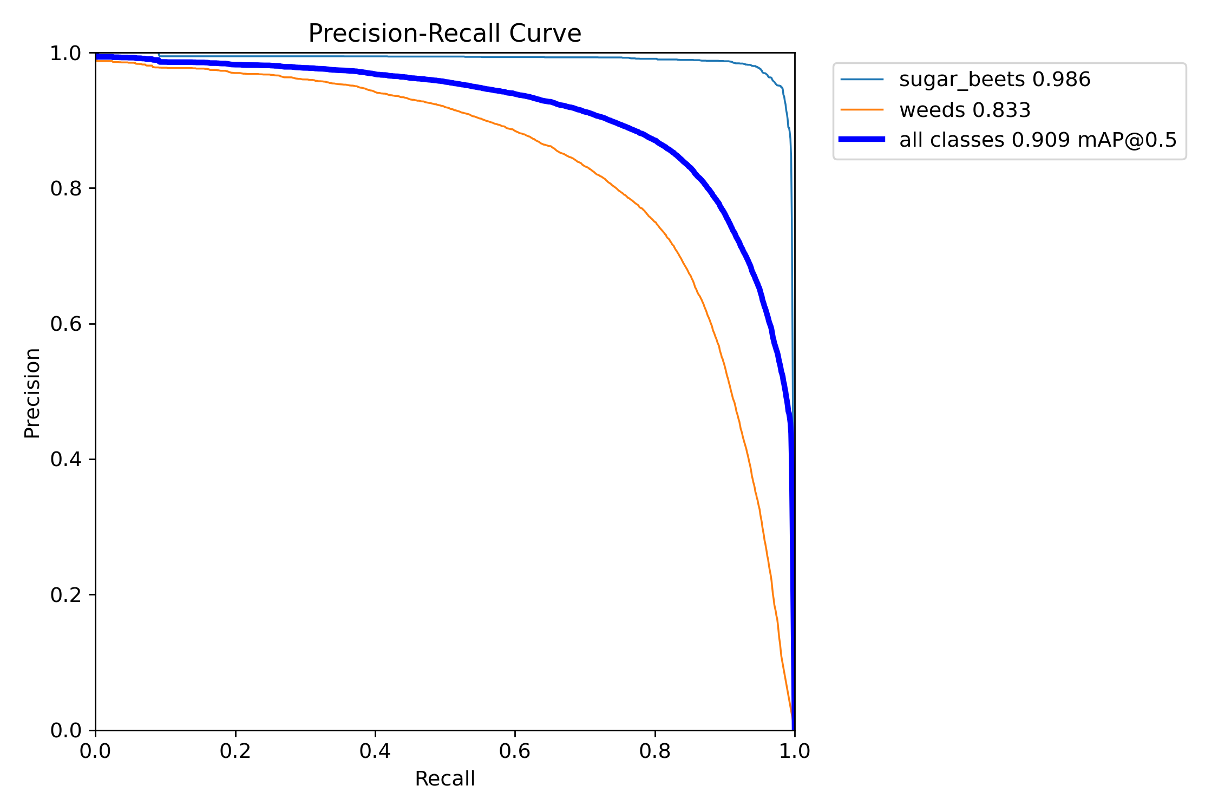
Model performance metrics
The Precision-Recall curve illustrates the trade-off between precision (positive prediction accuracy) and recall (true positive rate). This metric is especially useful when dealing with imbalanced datasets.

Slide 13
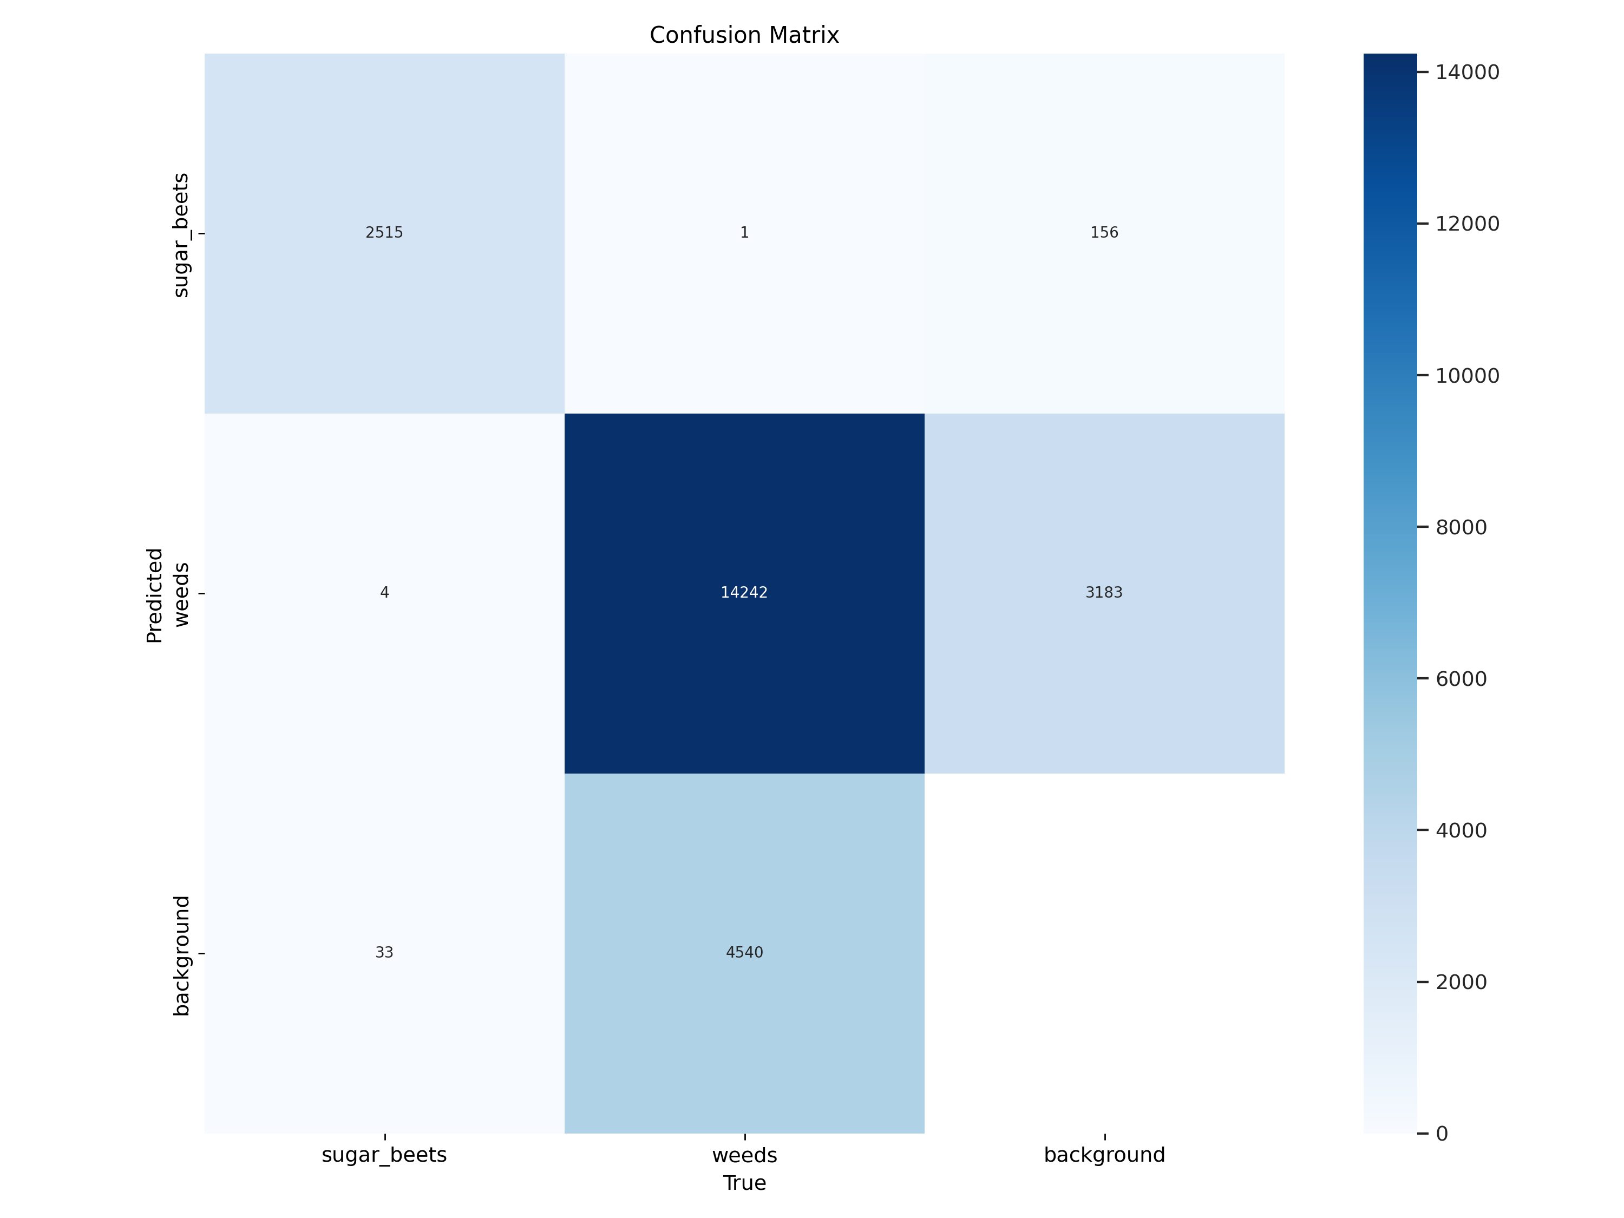
Model performance metrics
The model demonstrates strong performance in identifying weeds, achieving a high number of correct predictions. While it occasionally misclassifies sugar beets as weeds or background, and vice versa, the overall accuracy for weed detection is notable.

Slide 14
Future work
Enhance the system’s detection capabilities to accurately identify and differentiate between specific weed species, enabling more targeted and effective management strategies for diverse agricultural environments.
Deploy the solution at the edge to support real-time processing and decision-making within in-field robotic platforms, ensuring immediate response and minimal latency for precision agriculture applications.
Design and develop an intuitive, user-friendly interface tailored for agricultural technicians and field operators, making it easier to monitor, control, and interpret system outputs without requiring advanced technical knowledge.
Enable seamless integration with automated weed removal machinery and systems, facilitating a fully automated workflow from weed detection to physical elimination, thereby improving operational efficiency and reducing manual labor.

Slide 15
acknowledgements
Roboflow for providing the comprehensive Sugar Beets dataset
Ultralytics for the powerful YOLOv12s implementation
Kaggle for computing resources used during model training

Slide 16
References & links
Github Repo
Robflow
Sugar beet Dataset
YOLO V12
Sugar Beet Notebook
Evaluation Metrics
Predictions

Slide 17

Thank you

